Slide 1
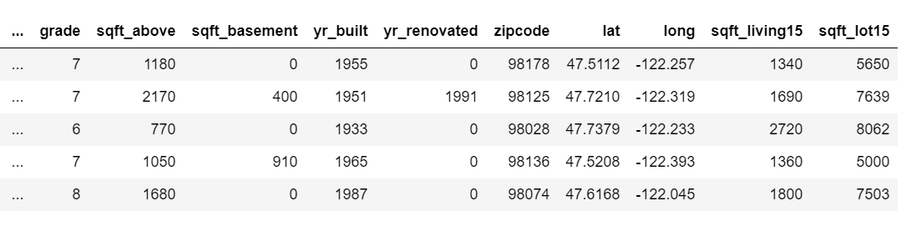
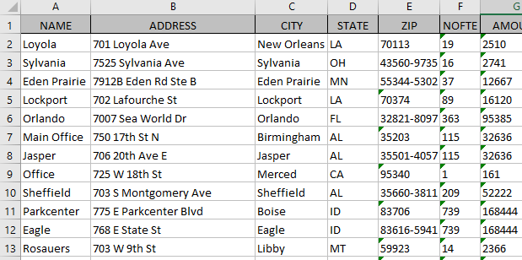
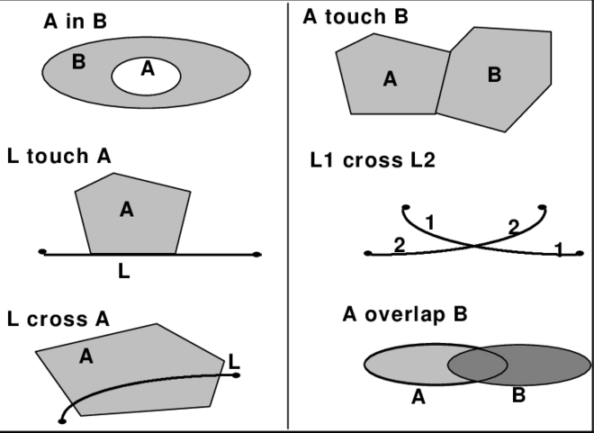
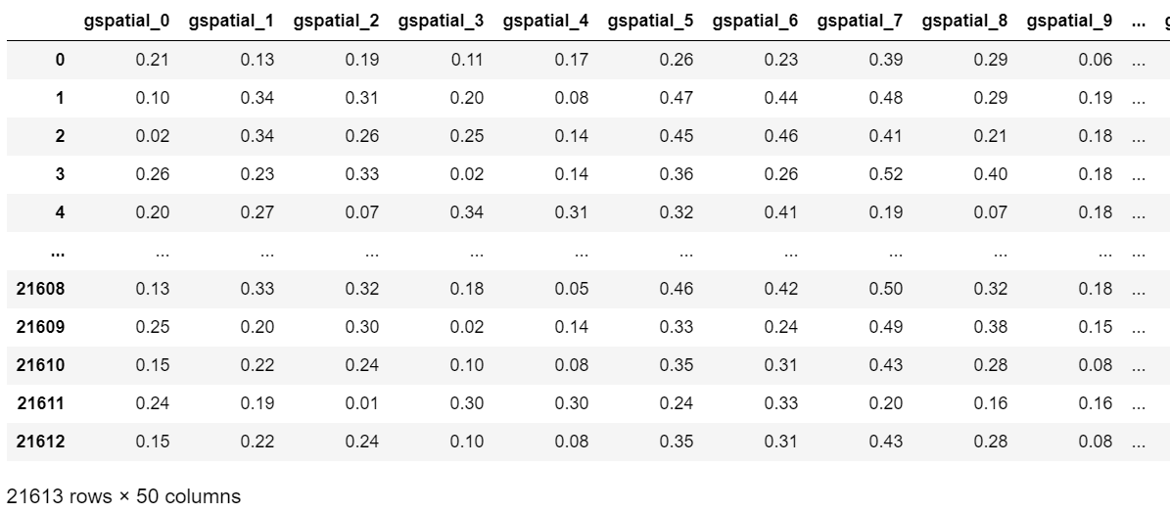
Where we are now in GPEC 447
Dissolve and merge
Geocoding
Spatial join
Topological relationships
Distances, and other spatial measures

Slide 2
GPEC 447: Introduction to Machine Learning for Spatial Data
Some slide credits:
Introduction to machine learning/AI, by Geert Jan Bex, Jan Ooghe, Ehsan Moravveji, VLAAMS Supercomputer Centrum, Belgium
Introduction to Machine Learning, by Eric Eaton, UPenn
Introduction to Machine Learning, by Dhruv Batra, Virginia Tech
Machine Learning, Pedro Domingos, Univ of Washington
Foundations of Machine Learning, by Ganesh Ramakrishnan, IIT Bombay

Slide 3
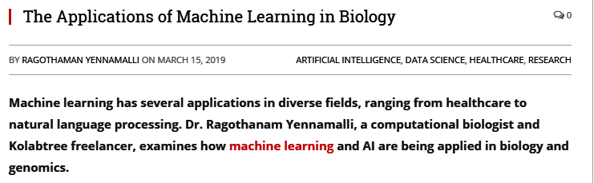
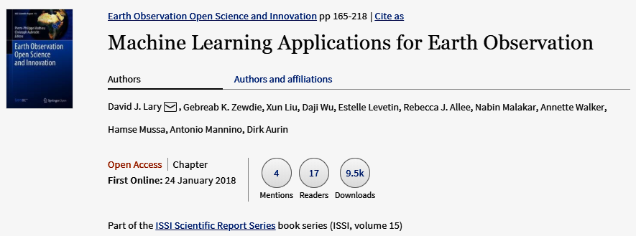


Applications in science

Slide 4
A Few Quotes
“A breakthrough in machine learning would be worth ten Microsofts” (Bill Gates, Chairman, Microsoft)
“Machine learning is the next Internet” (Tony Tether, Director, DARPA)
Machine learning is the hot new thing” (John Hennessy, President, Stanford)
“Web rankings today are mostly a matter of machine learning” (Prabhakar Raghavan, Dir. Research, Yahoo)
“Machine learning is going to result in a real revolution” (Greg Papadopoulos, CTO, Sun)
“Machine learning is today’s discontinuity” (Jerry Yang, CEO, Yahoo)

Slide 5
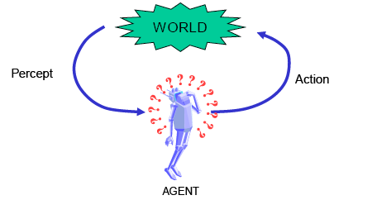
Intelligence
Ability for abstract thought, understanding, communication, reasoning, planning, emotional intelligence, problem solving, learning
The ability to learn and/or adapt is generally considered a hallmark of intelligence
Learning: “the acquisition of knowledge or skills through experience, study, or by being taught.”

Slide 6
What is Machine Learning?
[Arthur Samuel, 1959]
Field of study that gives computers
the ability to learn without being explicitly programmed
[Kevin Murphy] algorithms that
automatically detect patterns in data
use the uncovered patterns to predict future data or other outcomes of interest
[Tom Mitchell] algorithms that
improve their performance (P)
at some task (T)
with experience (E)

Slide 7

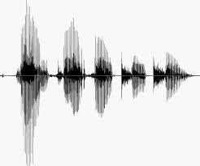
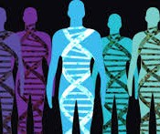
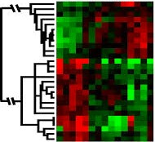
When Do We Use Machine Learning?
ML is used when:
Human expertise does not exist (navigating on Mars)
Humans can’t explain their expertise (speech recognition)
Models must be customized (personalized medicine)
Models are based on huge amounts of data (genomics)
Learning isn’t always useful:
There is no need to “learn” to calculate payroll
Based on slide by E. Alpaydin
5

Slide 8
Traditional Programming
Machine Learning
Data
Computer
Output
Program
Data
Computer
Program
Output

Slide 9
What is Machine Learning?
If you are a Scientist
If you are an Engineer / Entrepreneur
Get lots of data
Machine Learning
???
Profit!
Machine Learning
Data
Understanding

Slide 10
ML in a Nutshell
Tens of thousands of machine learning algorithms
Hundreds new every year
Every machine learning algorithm has three components:
Representation
Decision trees, Random forest, Support vector machines, etc.
Evaluation
Accuracy, precision/recall, squared error, entropy, cost/utility, etc.
Optimization
Gradient descent, greedy search, etc.

Slide 11
Types of Learning
Supervised (inductive) learning
Training data includes desired outputs
Unsupervised learning
Training data does not include desired outputs
Semi-supervised learning
Training data includes a few desired outputs
Reinforcement learning
Rewards from sequence of actions

Slide 12
Tasks
Supervised Learning
x
Classification
y
Discrete
x
Regression
y
Continuous
Unsupervised Learning
x
Clustering
y
Discrete ID
x
Dimensionality Reduction
y
Continuous

Slide 13
Supervised Learning
Regression
x
Regression
y
Continuous

Slide 14
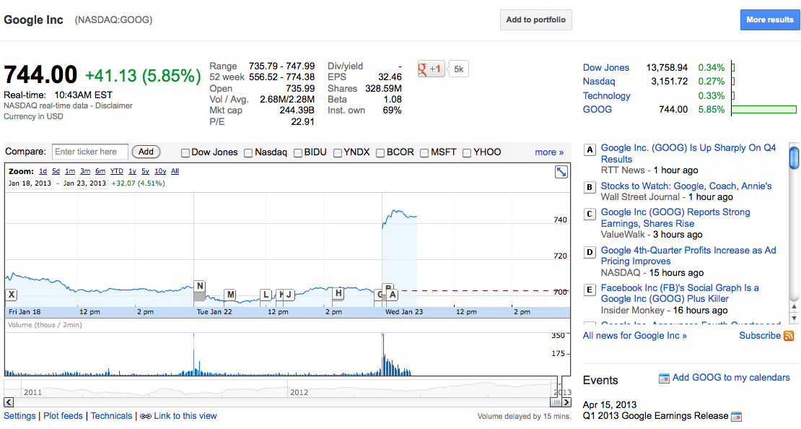
Stock market
‹#›

Slide 15

Weather prediction
Temperature
Slide Credit: Carlos Guestrin
‹#›

Slide 16
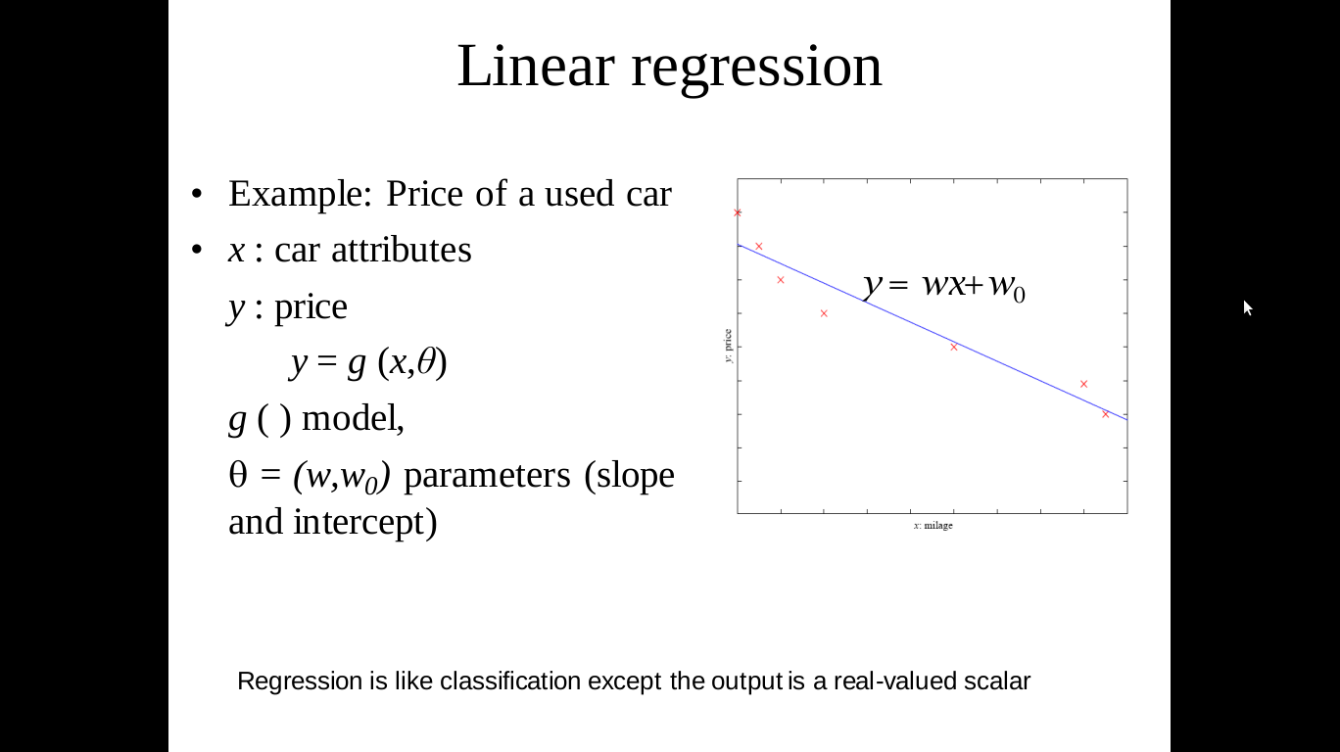
Regression
In Statistics:
the goal is to analyze relationship between dependent and independent variables, test hypotheses, and make predictions
In Machine Learning:
the goal is learn a function that maps input features to continuous output var, to better predict future outcomes. Features can be numeric and categorical. And datasets tend to be larger. The learned relationship may be presented as an equation, or may be a decision tree, etc.
Linear regression
Uses
Stock Prediction
Outlier detection

Slide 17

Statistics vs Machine Learning
In Stat: find a line that minimizes the mean squared error (MSE) across all of the data, assuming the data is a linear regressor with some Gaussian noise (typically)
Focus: statistical inference (characterizing the relationship for all the data; interpretation)
In ML: split the data into training and testing set, learn the behavior from the training set, and see how it performs on the test set.
Focus: prediction, ideally a robust one. Interpretability is desired but secondary
If in our ML regression model we use MSE as the loss function, and minimize MSE doing “empirical risk minimization” (ERM) - then we end up with an equivalent model
ERM: a learning algorithm that chooses the function that minimizes the empirical risk.
See an excellent intro at https://towardsdatascience.com/the-actual-difference-between-statistics-and-machine-learning-64b49f07ea3

Slide 18
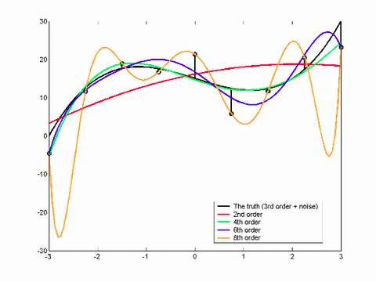
All models are not good
Constrain the parameters

Slide 19
Supervised Learning
Classification
x
Classification
y
Discrete

Slide 20
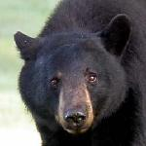
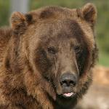
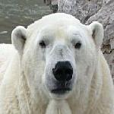
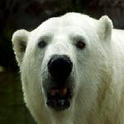
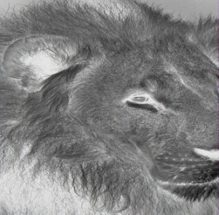

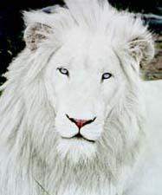
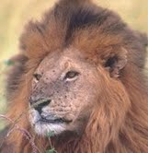



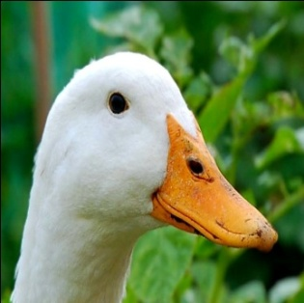



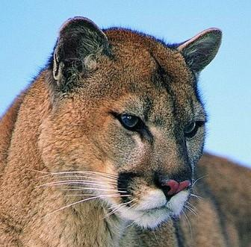
Supervised Classification example
f1
f2
f3
f4
Class label
d1
BearHead
???
d2
DuckHead
d3
LionHead
Source: LHI Animal Faces Dataset

Slide 21
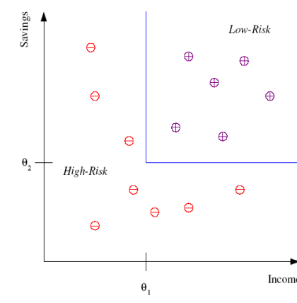
Classification
Example:
Credit Scoring
Goal:
Differentiating between high-risk and low-risk customers based on their income and savings
Discriminant:
IF income > θ₁ AND savings > θ₂ THEN low-risk ELSE high-risk
Discriminant is called 'hypothesis'
Input attribute space is called 'Feature Space'
Here Input data is 2-dimensional and the output is binary

Slide 22
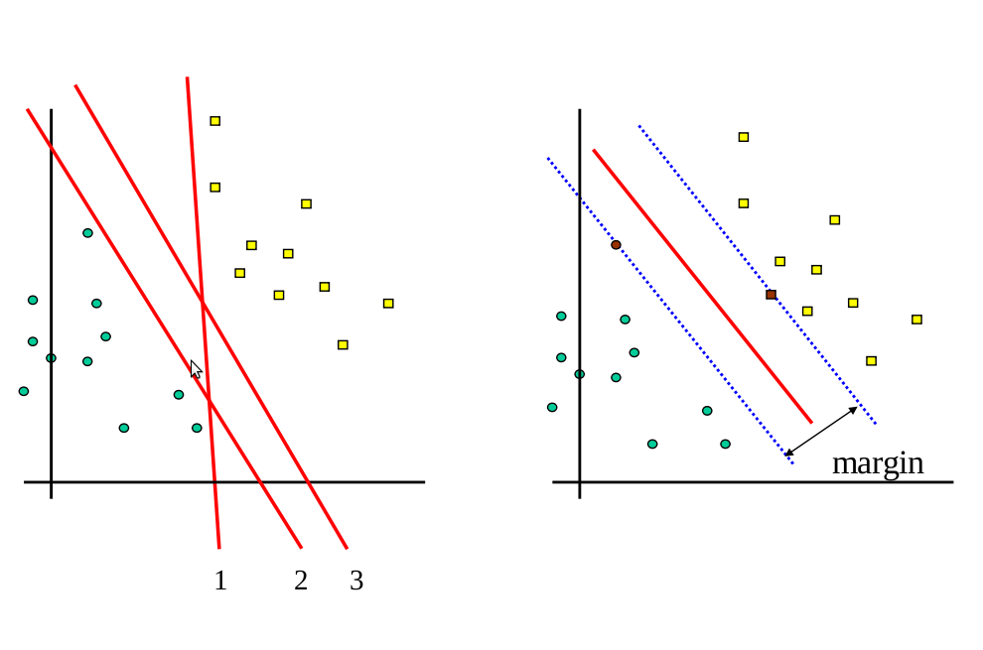
Which linear hypothesis is better
Max – Margin Classifier

Slide 23
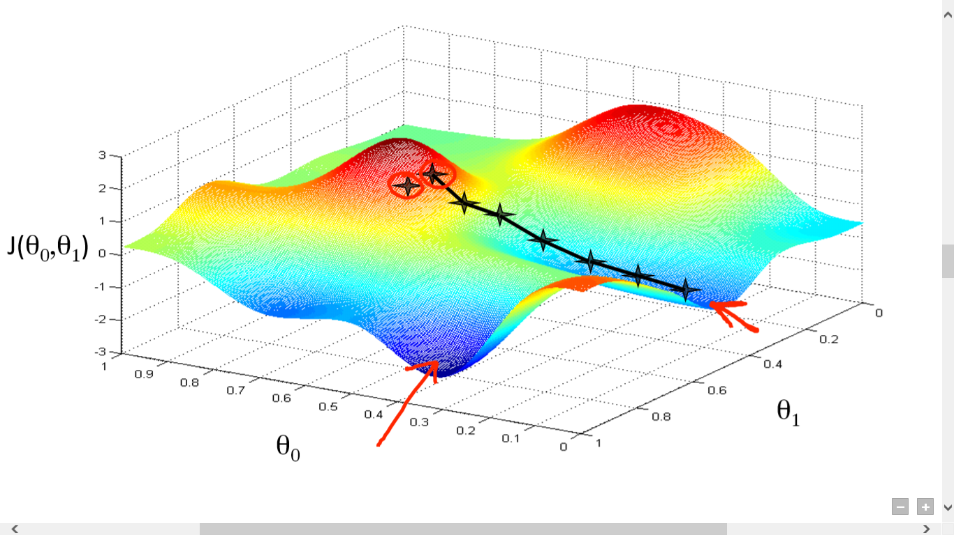
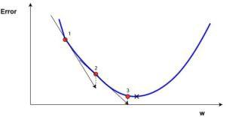
Gradient Descent – the most used algorithm in ML
Minimize cost function == find the deepest valley in that function
Follow the steepest slope(derivative of the cost function) to reach a local minimum
Once the direction is found 🡪 figure out how far to nudge. This is defined by a learning rate.

Slide 24
Unsupervised Learning
Labels may be too expensive to generate or may be completely unknown
There is lots of training data but with no class labels assigned to it

Slide 25
Unsupervised Learning
Clustering
Unsupervised Learning
Y not provided
x
Clustering
y
Discrete

Slide 26


???
Source: LHI Animal Faces Dataset

Slide 27
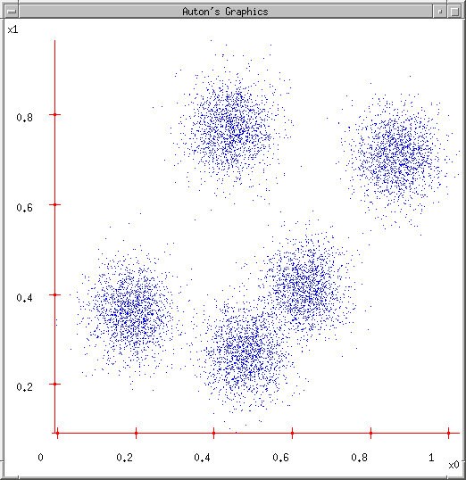
Clustering Data: Group similar things
Slide Credit: Carlos Guestrin
‹#›

Slide 28
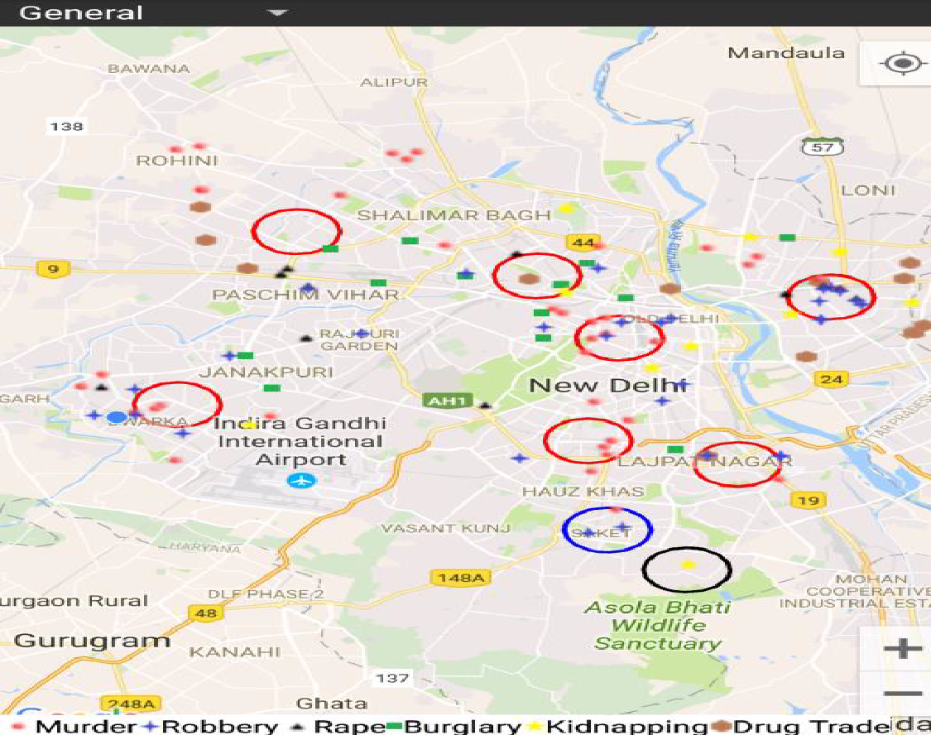
Clustering
Crime prediction using k-means clustering
http://www.grdjournals.com/uploads/article/GRDJE/V02/I05/0176/GRDJEV02I050176.pdf

Slide 29
Unsupervised Learning
Dimensionality Reduction / Embedding
Unsupervised Learning
Y not provided
x
Dimensionality reduction
y
Continuous
In Stats: PCA, factor analysis
In ML: feature selection, feature extraction

Slide 30
Semi-Supervised Learning
Supervised learning + Additional unlabeled data
Unsupervised learning + Additional labeled data
Learning Algorithm:
Start from the labeled data to build an initial classifier
Use the unlabeled data to enhance the model
Some Techniques:
Co-Training: two or more learners can be trained using an independent set of different features
Or to model joint probability distribution of the features and labels

Slide 31
Reinforcement Learning
Learning from feedback
x
Reinforcement Learning
y
Actions

Slide 32
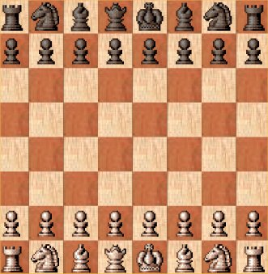
Reinforcement Learning: Learning to act
There is only one “supervised” signal at the end of the game.
But you need to make a move at every step
RL deals with “credit assignment”
Slide Credit: Fei Sha

Slide 33
Reinforcement Learning
Given a sequence of states and actions with (delayed) rewards, output a policy
Policy is a mapping from states 🡺 actions that tells you what to do in a given state
Examples:
Credit assignment problem
Game playing
Robot in a maze
Balance a pole on your hand
36

Slide 34
Active Learning
Unlabeled data is easy to obtain; but labels may be very expensive
For e.g. Speech recognizer
Active Learning
Initially all data labels are hidden
There is some charge for revealing every label
Active Learner will interactively query the user for labels
By intelligent querying, a lot less number of labels will be required than in usual supervised training
But a bad algorithm might focus on unimportant or invalid examples

Slide 35


Spam vs Regular Email

Slide 36
Intuition
Spam Emails
a lot of words like
“money”
“free”
“bank account”
“viagara” ... in a single email
Regular Emails
word usage pattern is more spread out
Slide Credit: Fei Sha

Slide 37
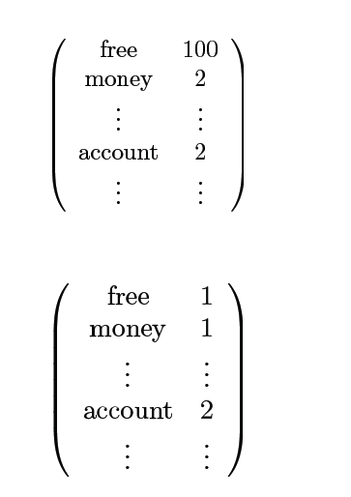
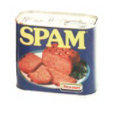
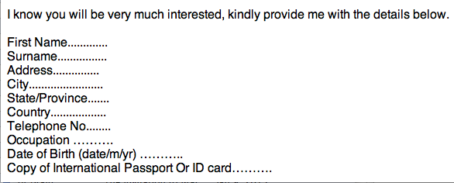
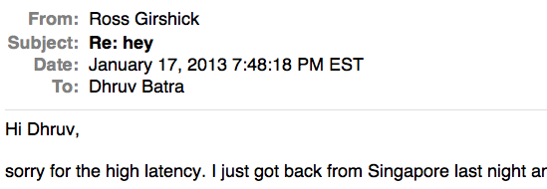
Simple Strategy: Let us count!
This is X
Slide Credit: Fei Sha

Slide 38
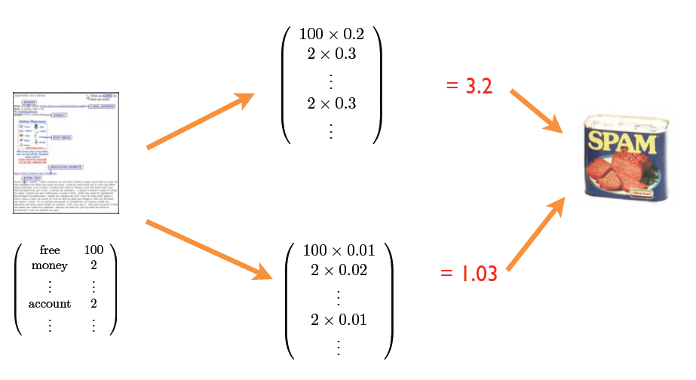
Final Procedure
Confidence / performance guarantee?
Why linear combination?
Why these words?
Where do the weights come from?
Slide Credit: Fei Sha

Slide 39
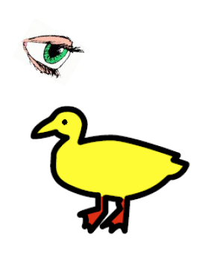
“I saw her duck”
Image Credit: Liang Huang

Slide 40
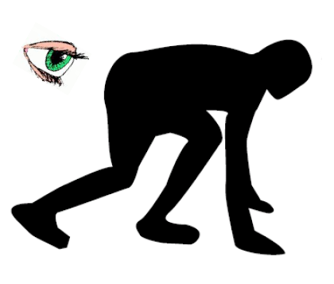
“I saw her duck”
Image Credit: Liang Huang

Slide 41
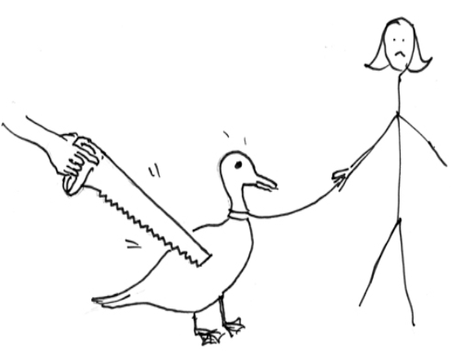
“I saw her duck”
Image Credit: Liang Huang

Slide 42
“I saw her duck with a telescope…”
Image Credit: Liang Huang

Slide 43
Tasks
Supervised Learning
x
Classification
y
Discrete
x
Regression
y
Continuous
Unsupervised Learning
x
Clustering
y
Discrete ID
x
Dimensionality Reduction
y
Continuous

Slide 44

Machine learning algorithms
Regression: Ridge regression, Support Vector Machines, Random Forest, Multilayer Neural Networks, Deep Neural Networks, ...
Classification: Naive Base, , Support Vector Machines, Random Forest, Multilayer Neural Networks, Deep Neural Networks, ...
Clustering: k-Means, Hierarchical Clustering, ...

Slide 45
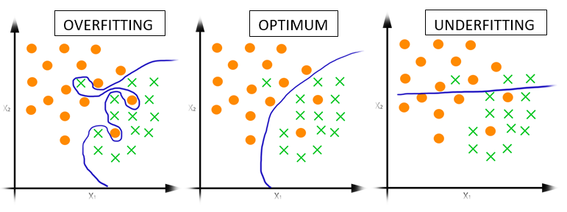
Supervised learning: methodology
Select model, e.g., random forest, (deep) neural network, ...
Train model, i.e., determine parameters
Data: input + output
training data → determine model parameters
validation data → yardstick to avoid overfitting
Test model
Data: input + output
testing data → final scoring of the model
Production
Data: input → predict output

Slide 46

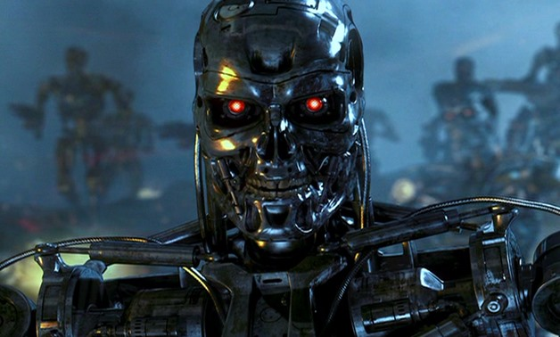
Issues
Many machine learning/AI projects fail (Gartner claims 85 %)
Ethics, e.g., Amazon has/had sub-par employees fired by an AI automatically
See discussion this week, around the use of AI to write prose :
Steven Johnson “A.I. Is Mastering Language. Should We Trust What It Says? NYTimes Magazine, https://www.nytimes.com/2022/04/15/magazine/ai-language.html
Emily Bender “On NYT Magazine on AI: Resist the Urge to be Impressed”, Apr 17th (https://medium.com/@emilymenonbender/on-nyt-magazine-on-ai-resist-the-urge-to-be-impressed-3d92fd9a0edd)

Slide 47

Reasons for failure
Asking the wrong question
Trying to solve the wrong problem
Not having enough data
Not having the right data
Having too much data
Hiring the wrong people
Using the wrong tools
Not having the right model
Not having the right yardstick
Notes:
https://www.kdnuggets.com/2018/07/why-machine-learning-project-fail.html

Slide 48
Frameworks
Programming languages
Python
R
C++
...
Many libraries
scikit-learn
PyTorch
TensorFlow
Keras
…
Fast-evolving ecosystem!
classic machine learning
deep learning frameworks

Slide 49

scikit-learn
Nice end-to-end framework
data exploration (+ pandas + holoviews)
data preprocessing (+ pandas)
cleaning/missing values
normalization
training
testing
application
"Classic" machine learning only
https://scikit-learn.org/stable/

Slide 50

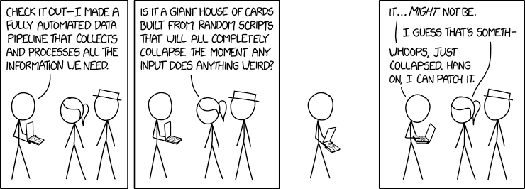
Data pipelines
Data ingestion
CSV/JSON/XML/H5 files, RDBMS, NoSQL, HTTP,...
Data cleaning
outliers/invalid values? → filter
missing values? → impute
Data transformation
scaling/normalization
Must be done systematically

Slide 51
Deep Learning notes

Slide 52
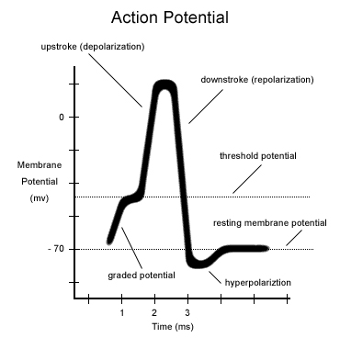
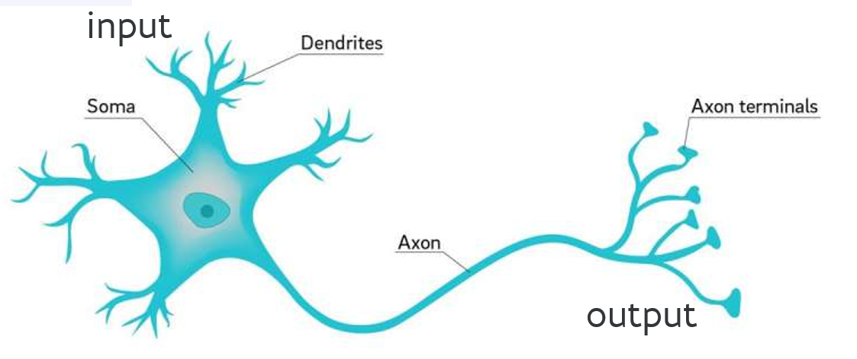
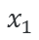
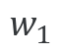
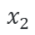
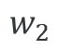

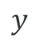
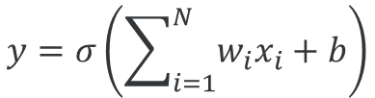
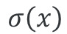
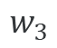






From neurons to ANNs
inspiration
activation function
...

Slide 53

Multilayer network
How to determine weights?

Slide 54

Training: backpropagation
Initialize weights "randomly"
For all training epochs
for all input-output in training set
using input, compute output (forward)
compare computed output with training output
adapt weights (backward) to improve output
if accuracy is good enough, stop

